Slide 1
“We are here to speak for ourselves, to decide our own strategies, and to plan our own futures. We are not here as members of minority groups or as adjuncts to male organizations but as Native women determined to link our peoples in a common cause for self-determination.”
HAUNANI-KAY TRASK

Slide 2
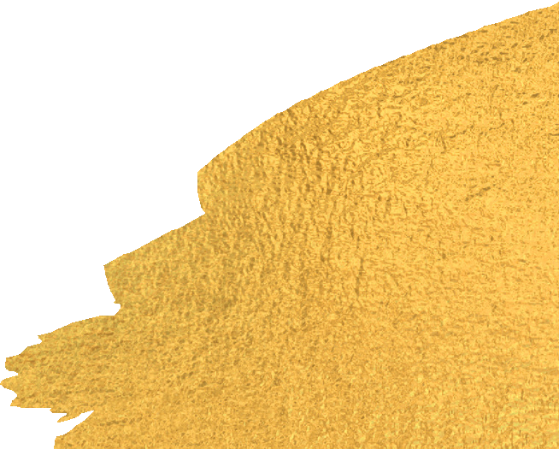
Pacific Islander Data Project
Birth Outcomes Data Workshop, May 2019

Slide 3
