Slide 2
Co-Sponsors

Slide 3
Agenda
Webinar Housekeeping
Introductions
Presentation 1
Presentation 2
Presentation 3
Presentation 4
Q & A
Closing Comments

Slide 4
Webinar Housekeeping Rules
This is a webinar format zoom call: your video and mic is off throughout the entire webinar.
Ask your questions for the speakers by clicking the q & a icon on the bottom and then clicking to all panelists and attendees.
If you have any other comments to the speakers, please drop those into the chat box.
If you have any technical questions our technical support team Priya, Josh, and Hurjessica will be able to assist you!
The webinar will be recorded and will be posted on designated program website(s) for participants to view.
Thank you for your cooperation in making this a great webinar for us, the speakers, and the community!

Slide 5
Calvin Slides

Slide 12
Alyshia Slides

Slide 13
“We are here to speak for ourselves, to decide our own strategies, and to plan our own futures. We are not here as members of minority groups or as adjuncts to male organizations but as Native women determined to link our peoples in a common cause for self-determination.”
HAUNANI-KAY TRASK

Slide 14
Pacific Islander Data Project
Birth Outcomes Data Workshop, May 2019

Slide 15
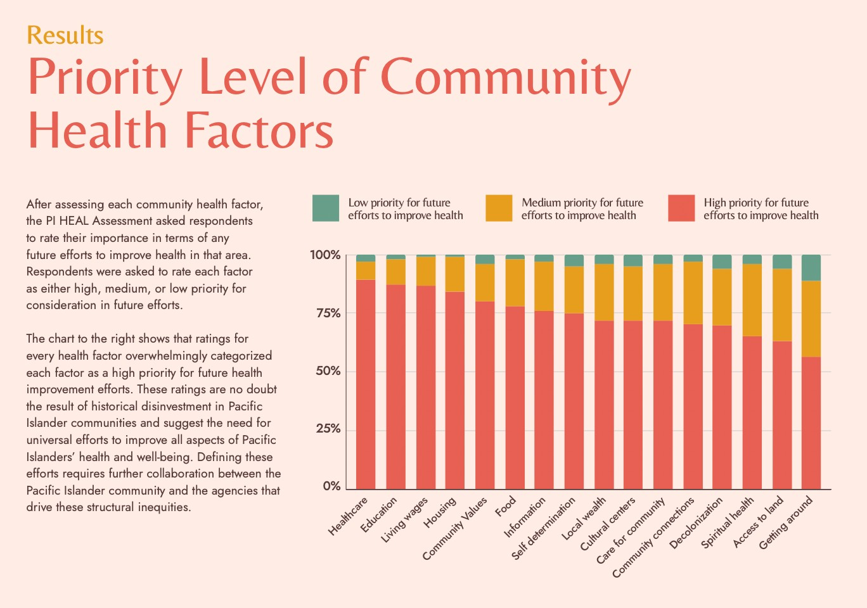

Slide 16
Jake Slides
https://health.utah.gov/disparities/it-takes-a-village/index.html

Slide 17
Sina Slides

Slide 18
Thank you for joining us! Stay on the look out for the second webinar of this series!

